Slide 1
FlipFIT

Slide 2
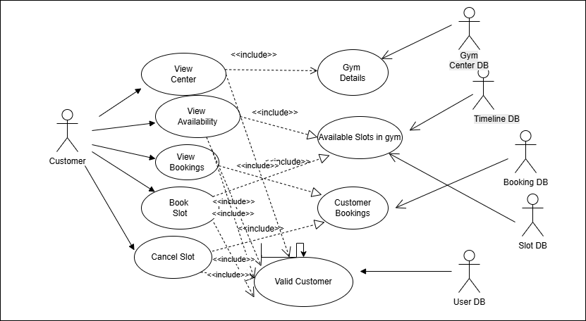
Use Case Customer UML Diagram

Slide 3
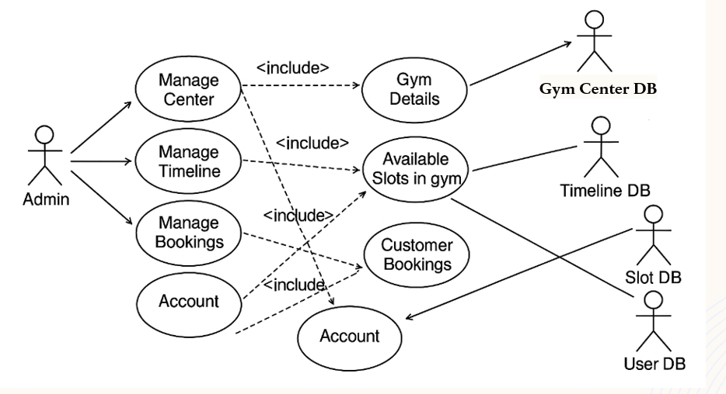
Use Case Admin UML Diagram
Manage Slots

Slide 4
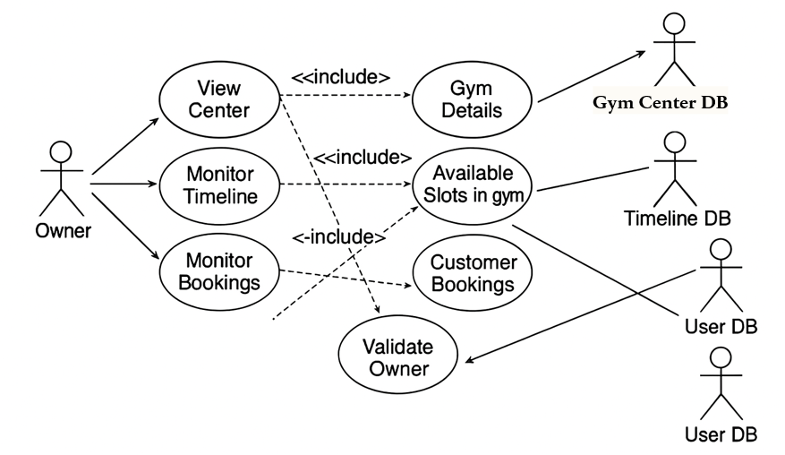
Use Case Owner UML Diagram

Slide 5
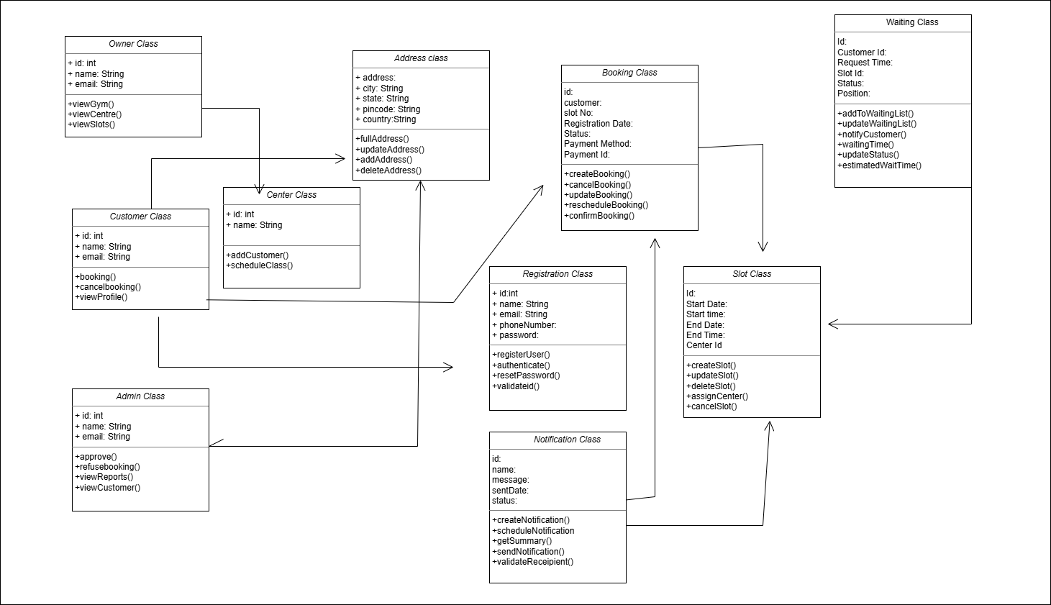

Slide 6
ActivityDiagram
Register/Login
User/Admin
Select Center
Select Date and Slot
Yes
Add to waiting List
Available ?
Confirm
Booking
Update
Database
Notify
Notify
User

